Slide 1
Discussion Unit:
Introduce DSE Studio
Understand where Studio fits in the DSE portfolio
Understand when/how you may choose to use DSE Studio
DSE Studio, Overview, (planned use)
Notes:
The goal of this Discussion Unit is to introduce DSE Studio; where Studio fits in the DSE portfolio, and to understand when and how you might use Studio.

Slide 2
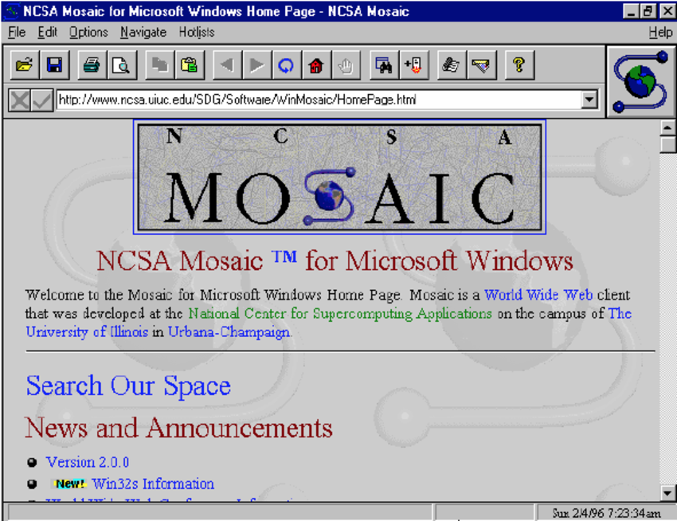
Discussion Lab:
Matching pairs – Match the attributes on the right with the areas on the left
NCSA Mosaic, or simply Mosaic, is the web browser that popularized the World Wide Web and the Internet. It was also a client for earlier internet protocols such as File Transfer Protocol, Network News Transfer Protocol, and Gopher. The browser was named for its support of multiple internet protocols.
Source: https://en.wikipedia.org/wiki/Mosaic_(web_browser)
Notes:
On the next page we enter a Discussion Lab.

Slide 3



Discussion Lab: Clients to DSE version 6 ?
Ops Center
Studio
Dev Center
DSE
DSBulk
Not DSE
DSFiber (H-NAS only)
GraphLoader
DSE supported drivers
Open source drivers
Box of Tissues
Source: http://www.spencer1984.com/my_models/beverly-hillbillies.php
Notes:
Matching pairs Discussion Lab: What comes with a DSE 6.x commercial license ?
Match the terms on the right with the DSE/not-DSE tag on the left.
From, http://www.spencer1984.com/my_models/beverly-hillbillies.php
"The famous Hillbillies' truck (actually a 1921 Oldsmobile) didn't belong to any of the main characters - it was on loan from Jed's cousin Pearl, who lent it to him under the condition that he watched after Jethro.

Slide 4
End of Discussion Lab:
Notes:
End of Discussion Lab-

Slide 5
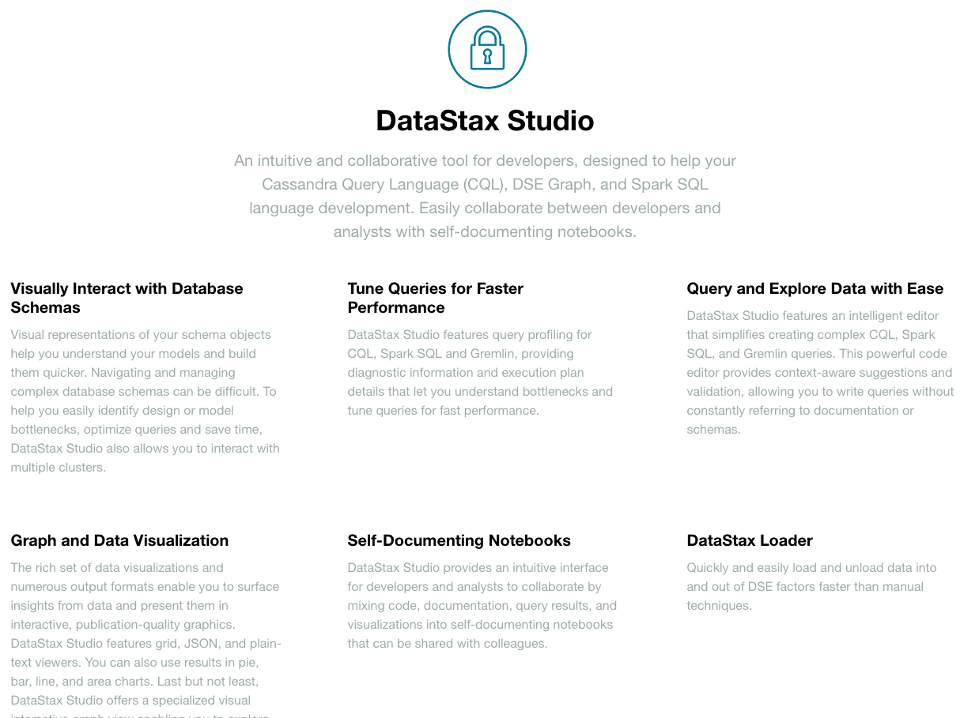
DSE Studio:
Based on Zeppelin notebook
Runs locally; (lightweight) Web app
Supports:
-- CQL (and Search)
-- Spark/SQL (w/ Always
on SQL)
-- Gremlin
-- Markdown
Import/export, w/w-o data
Content assist (Shift-ENTER)
Notes:
DSE Studio is Web based, and provides an interface similar to Apache Zeppelin.
Apache Zeppelin is detailed here,
https://en.wikipedia.org/wiki/Notebook_interface
https://zeppelin.apache.org/
And DSE Studio is detailed here,
https://www.datastax.com/products/datastax-studio-and-development-tools
A brief compare and contrast between DSE Studio and CQLSH:
Where CQLSH can run CQL and a small number of (CQLSH control/directive) statements), Studio can run CQL, Spark/SQL, and Gremlin (the TinkerPop graph traversal language).
Studio can also display end user created markdown (to document a Notebook’s contents), and be shared with or without result sets (the output from any/all queries).
CQLSH is command line, and Studio is graphical, a thin client Web based.
The query result set in Studio is context aware, and will offer up to 8 or more graphical charting capabilities so that the end user can better understand the results.
A graphical schema explorer comes with Studio, super handy for exploring graphs.

Slide 6
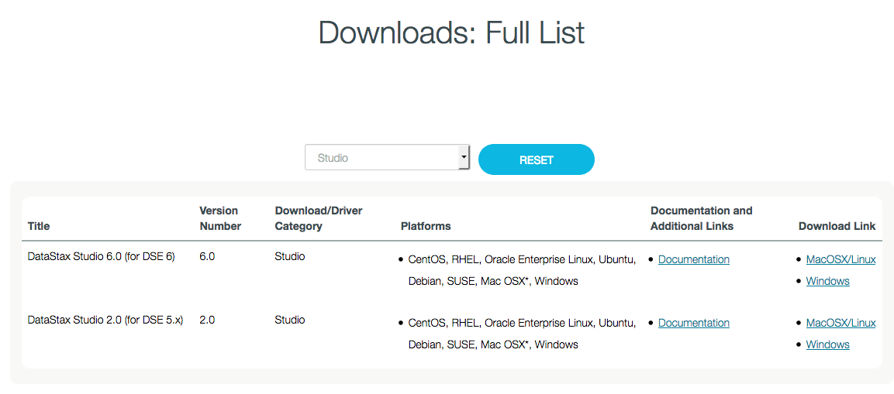
DSE Studio: Download, boot
Download from Academy
./server.sh
Notes:
DSE Studio is available for download from the following Urls,
Documentation page, including installation instructions, https://docs.datastax.com/en/dse/6.0/dse-dev/datastax_enterprise/studio/studioToc.html
Download page proper, https://academy.datastax.com/all-downloads
On MAC and Linux, the above distribution arrives as a Tar ball; unpack in a given parent directory.
We commonly unpack ours in /opt/studio.
A standard Linux filesystem (sub) structure; bin, conf, lib, logs, other. While there is a configuration.yaml under ./conf, DSE Studio will operate fine in
many cases with no edits to same.
Under the ./bin directory, execute a, ./server.sh
This command will cause DSE Studio to run in the foreground; use CONTROL-C to terminate DSE Studio.

Slide 7
DSE Studio: Boot process
# ./server.sh
Starting Studio. This may take a few minutes. You will be notified here when Studio is ready.
SLF4J: Class path contains multiple SLF4J bindings.
SLF4J: Found binding in [jar:file:/opt/studio/lib/log4j-slf4j-impl-2.9.0.jar!/org/slf4j/impl/StaticLogg erBinder.class]
SLF4J: Found binding in [jar:file:/opt/studio/tomcat.9091/webapps/api/WEB-INF/lib/log4j-slf4j-impl-2.9.0.jar!/org/slf4j/impl/StaticLoggerBinder.class]
SLF4J: See http://www.slf4j.org/codes.html#multiple_bindings for an explanation.
SLF4J: Actual binding is of type [org.apache.logging.slf4j.Log4jLoggerFactory]
Studio is now running at: http://localhost:9091
NOTE: Studio by default will only be accessible on this machine since it is bound to localhost.
Studio is intended to be used as a desktop application. To allow remote connections(which can be a security risk) modify the httpBindAddress setting in configuration.yaml to either a publicly accessible address or 0.0.0.0
Please visit https://docs.datastax.com/en/dse/6.0/dse-dev/datastax_enterprise/studio/configStudio.html for more information on configuration
Notes:
As displayed above, DSE Studio is now available by default on localhost, port 9091. You can change the listening IP address and port.
DSE Studio can connect to any active DSE server instance that you have permission and connectivity to.

Slide 8
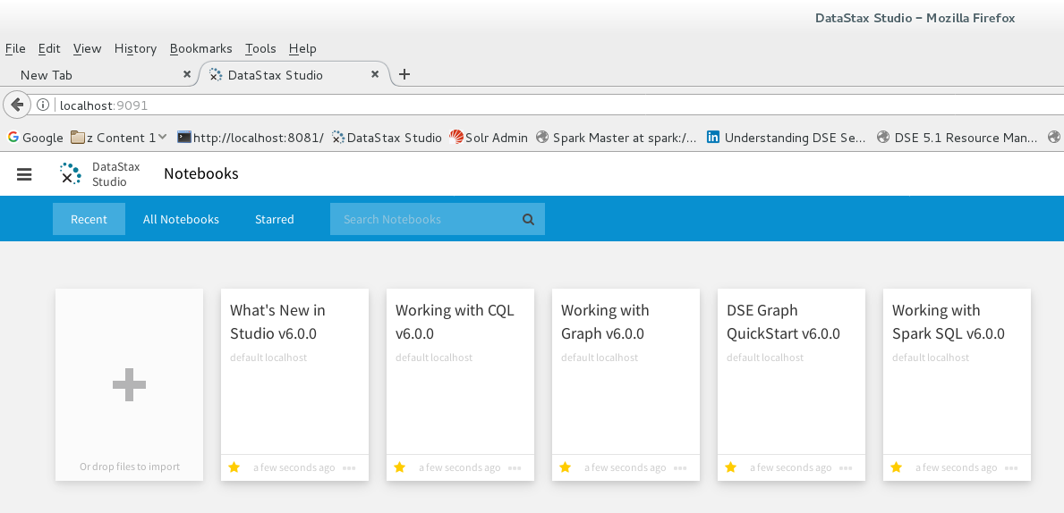
DSE Studio: First Steps
Notes:
Relative to the figure above, the following is offered:
In the (main content area) are (n) training Notebooks that ship with Studio, and a large plus (+) symbol.
-- This (main content area) will become a palette, once a Notebook is open; the area on the screen where Notebooks proper are edited and operated.
-- To import Notebooks created on other machines or by other users, drag and drop the (new) Notebook onto this area of the screen, when this area of the screen is current (on display).
Exported Notebooks arrive as a Zip file, previously created by DSE Studio.
Above the blue menu bar, is the tool bar, with a number of icons. Left to right, these icons include:
The (three line) menu button offers 3 further choices-
-- Notebooks, which is this current display. You can use this option to return to this (current) screen when inside a Notebook, other.
-- Connections, which offers the ability to Add, Delete, and Update a set of metadata (a connection) to a DSE server instance.
-- Import Notebook, which is another means to import previously created DSE Studio Notebooks. (Based on the current context within DSE Studio, this menu option may not always display.)
Note: While connections are reusable across Notebooks (connections exist as their own top level object with DSE Studio), each Notebook is also associated with a current (default) connection.
Thus, when you re-open a Notebook, it will know how to connect to its associated DSE server instance

Slide 9
DSE Studio: Create new (CQL) Notebook
Notes:
The modal dialog box to create a connection (Create Connection) to a DSE server.
There is a Test button, and DSE Studio supports all DSE supported security (authentication/authorization) schemes.

Slide 10
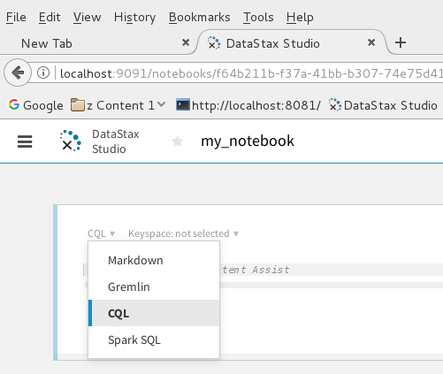
DSE Studio: Language within a Cell
Notes:
In the top left corner of each cell is a drop down list box wherein you may choose to:
Document the cell or Notebook as a whole; standard Markdown (MD) language
Enter and run CQL
Enter and Run Spark/SQL Ender and run Gremlin (the TinkerPop graph traversal language)
Each cell may contain a different value here.
Further:
The palette area is that area of the screen below the white tool bar. This area displays and allows interaction with the workbook proper.
Each (block / frame) on the palette it referred to as a, cell. You can add, drop, and edit cells using the plus symbol on the bottom-middle of any existing cell, or the ellipsis button on the top-right of each cell.
A cell is currently and exclusively one of four types, as listed in the drop
down list box:
-- Markdown allows free form edit of comments, end user created documentation, other. A cell of this type accepts markdown formatting meta characters.
A good markdown language cheat sheet is available on GitHub at, https://guides.github.com/pdfs/markdown-cheatsheet-online.pdf
-- CQL allows CQL syntax commands; CREATE KEYSPACE, CREATE TABLE, yadda.
-- Spark SQL allows the execution of Spark SQL (very compatible with HiveQL version 1.1).
-- And Gremlin allows the execution of Gremlin, the graph traversal language to TinkerPop.

Slide 11
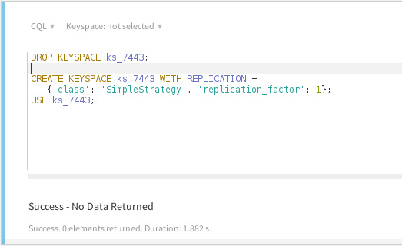
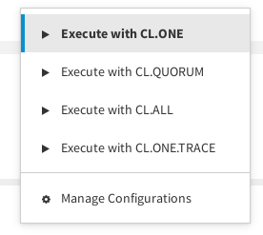
DSE Studio: Running CQL
Notes:
Most CQL commands are associated with a target keyspace. An exception would be; CQL code that creates or drops a keyspace, other.
On the upper right side of each cell is the run button (appears as a right arrow). Alongside the run button is a control to specify consistency level; one, all, other

Slide 12
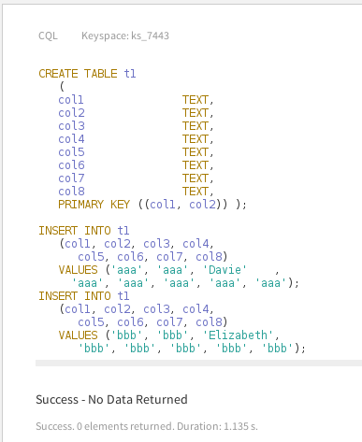
DSE Studio: Standard CQL
Notes:
This example shows a keyspace having been specified for a cell (ks_7443).

Slide 13
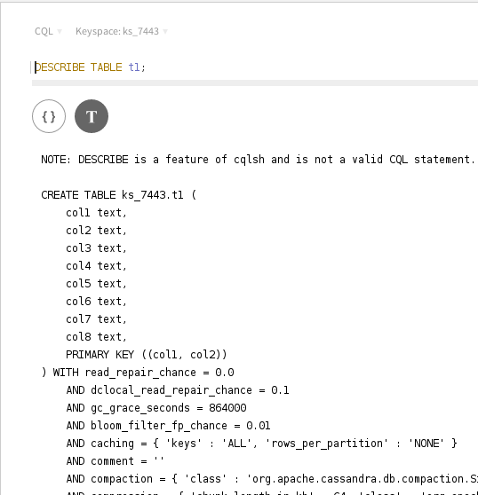
DSE Studio: Chart Types
Notes:
On run, DSE Studio CQL cells will produce a context sensitive number of chart types, that allow you to display results.
Here, a DESCRIBE TABLE command offers JSON and tabular result chart types.

Slide 14
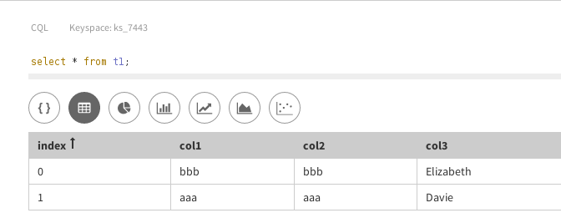
DSE Studio: More Chart Types
Notes:
A SELECT Statement, with its resultant data set, offers more chart types.

Slide 15
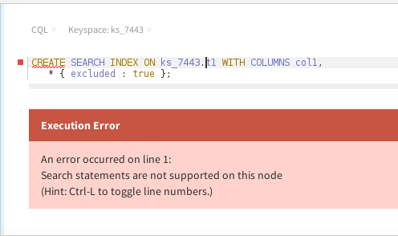
DSE Studio: Subject to the underlying DSE
Notes:
DSE Studio will produce a controlled error, should you request an operation that is not supported by the underlying DSE cluster.
In this case, we asked for a DSE Search operation.

Slide 16
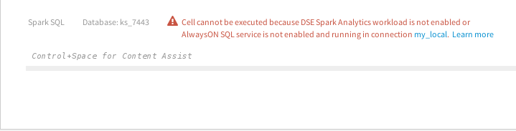
DSE Studio: Subject to the underlying DSE
Notes:
DSE Studio will produce a controlled error, should you request an operation that is not supported by the underlying DSE cluster.
In this case, we asked for a DSE Analytics operation; more specifically, an Always on SQL operation.

Slide 17
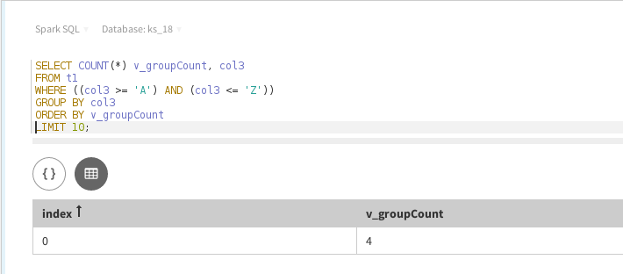
DSE Studio: Successful Spark/SQL
Notes:
And the result of a successful DSE Analytics (Spark/SQL) command.

Slide 18
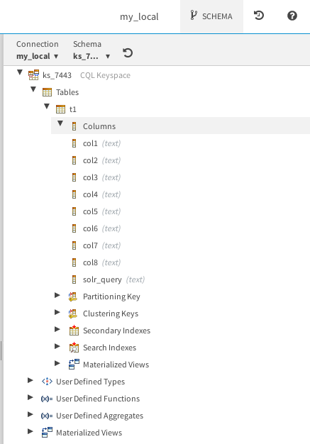
DSE Studio: Schema Explorer
Notes:
On the right hand side of the DSE Studio canvas is a Schema Explorer; in effect, a graphical means to DESCRIBE TABLE, and more.

Slide 19
Notes:
End of Discussion Module-

